Slide 1

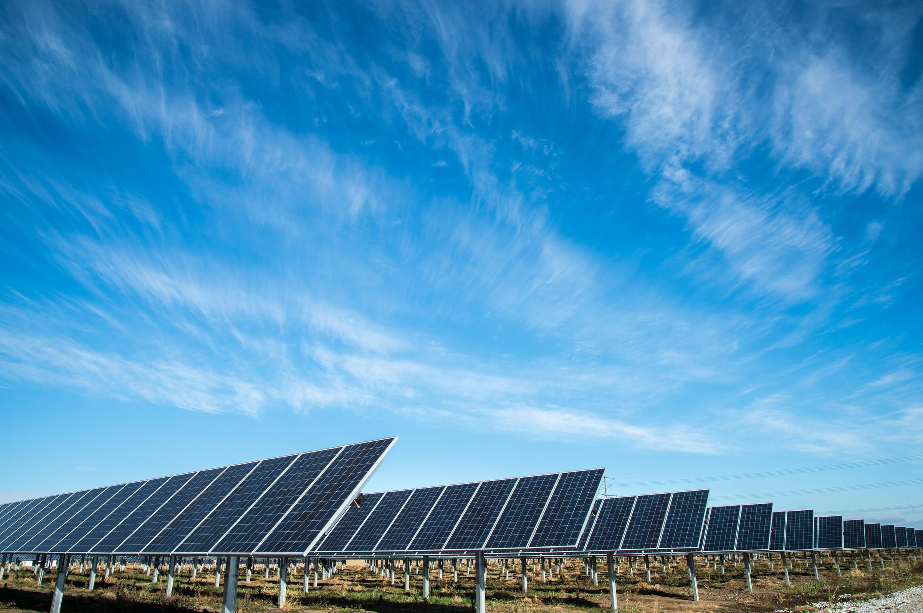
Team Zero
Levy Duivenvoorden Niels van Drunen Jefry el Bhwash Niels van Schaik Amin Mansouri

Slide 2
Today:
Project definition
Progress
Future
Question

Slide 3


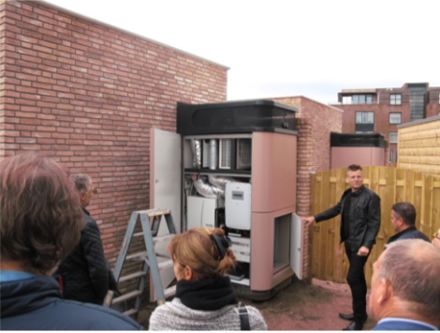
Project definition
What is Factory Zero?
Predict the power usage and generation, one day in advance.
What is the optimal model to predict energy use/production of a typical house one day in advance with optimal profit and most efficient use of the energy storage?
Source: Factory Zero iCEM 3005-e 2019-2020
Notes:
Afgelopen week was de defenitie van het project onduidelijk. Dit is de huidige definitie van ons project

Slide 4

Progress

Slide 5
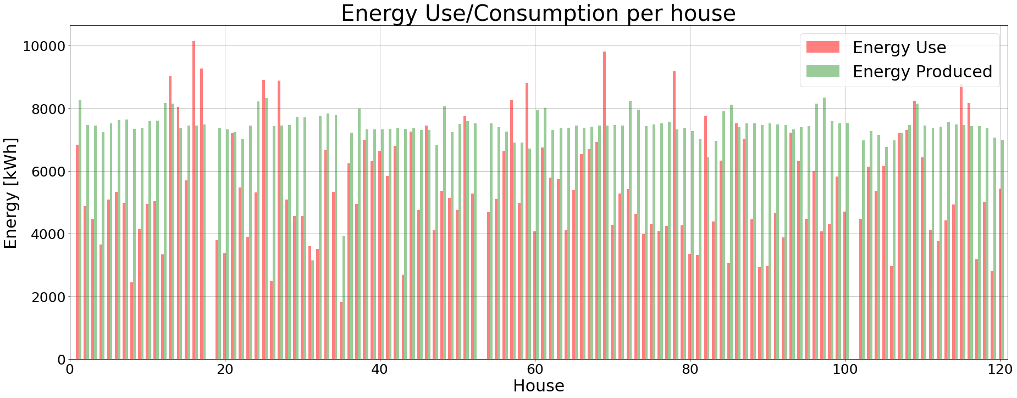
Progress

Slide 6
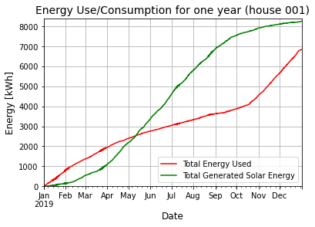
Progress

Slide 7
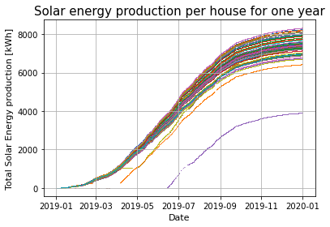
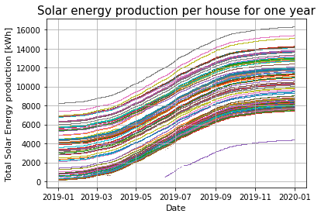
Progress

Slide 8

Future
Research plan
Lectures + datacamp
Literature
Data quality + fixes (data cleaning)
Regression on solar (*application of lectures)

Slide 9

Questions / Suggestions

